Slide 1
CHP 8 DFS

Slide 2
Basic Terminologies
File
Attributes
File System
DFS

Slide 3
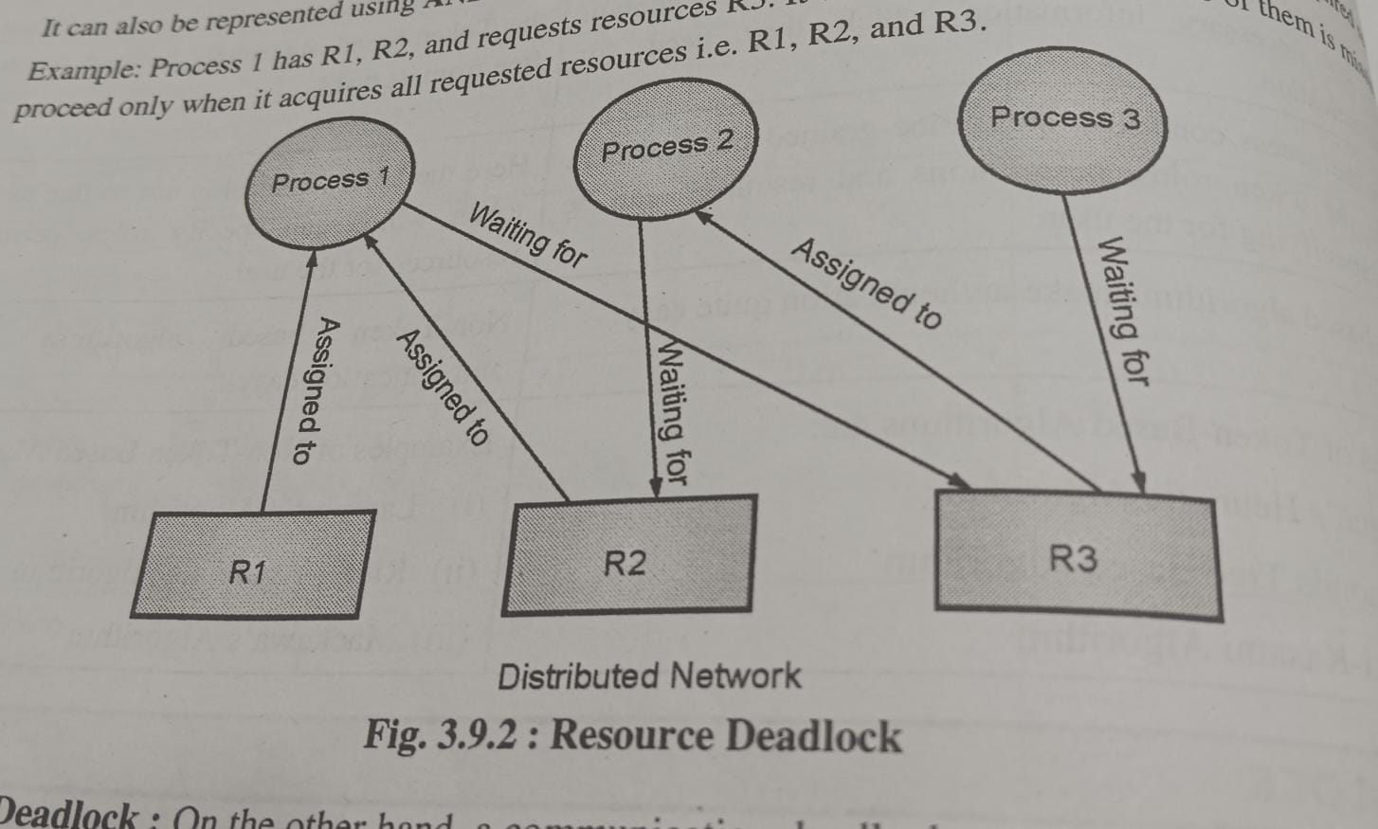

Slide 4
Services by DFS
True File System
Storage
Naming Transparency

Slide 5
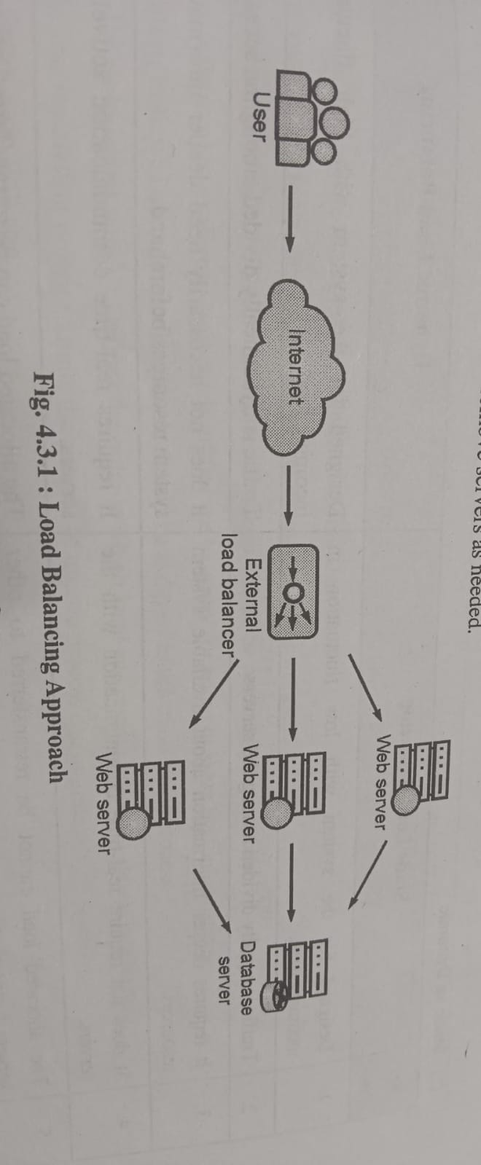

Slide 6
File Models
Structured
Indexed
Non Indexed
Non Structured
Mutable
Immutable

Slide 7
File Sharing Semantics
Unix
Session
Immutable
Transaction

Slide 8
Caching Scheme
Cache location
Server memory
Server Disk
Client Disk
Client Memory
Modification Propagation
Write back
Write through
Cache validation
Client
Server

Slide 9
Replication : Issues
Naming
Replication Control
Explicit
Implicit
Multicopy Update

Slide 10
Protocols of multi copy update
Read any write all
Available Copy
Primary Copy
Quorom based protocol

Slide 11
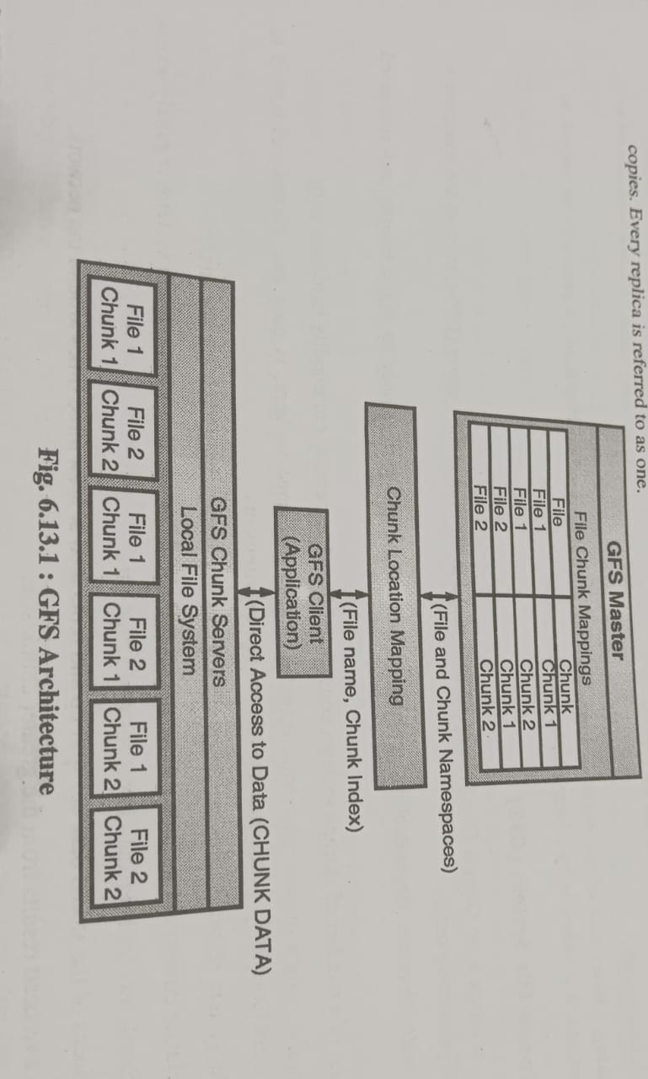

Slide 12
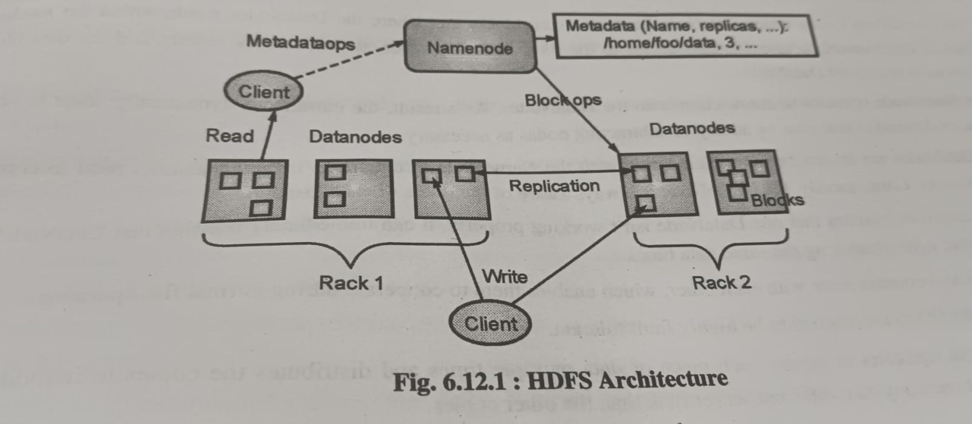
THANK YOU !!!!

Slide 13
